Slide 1
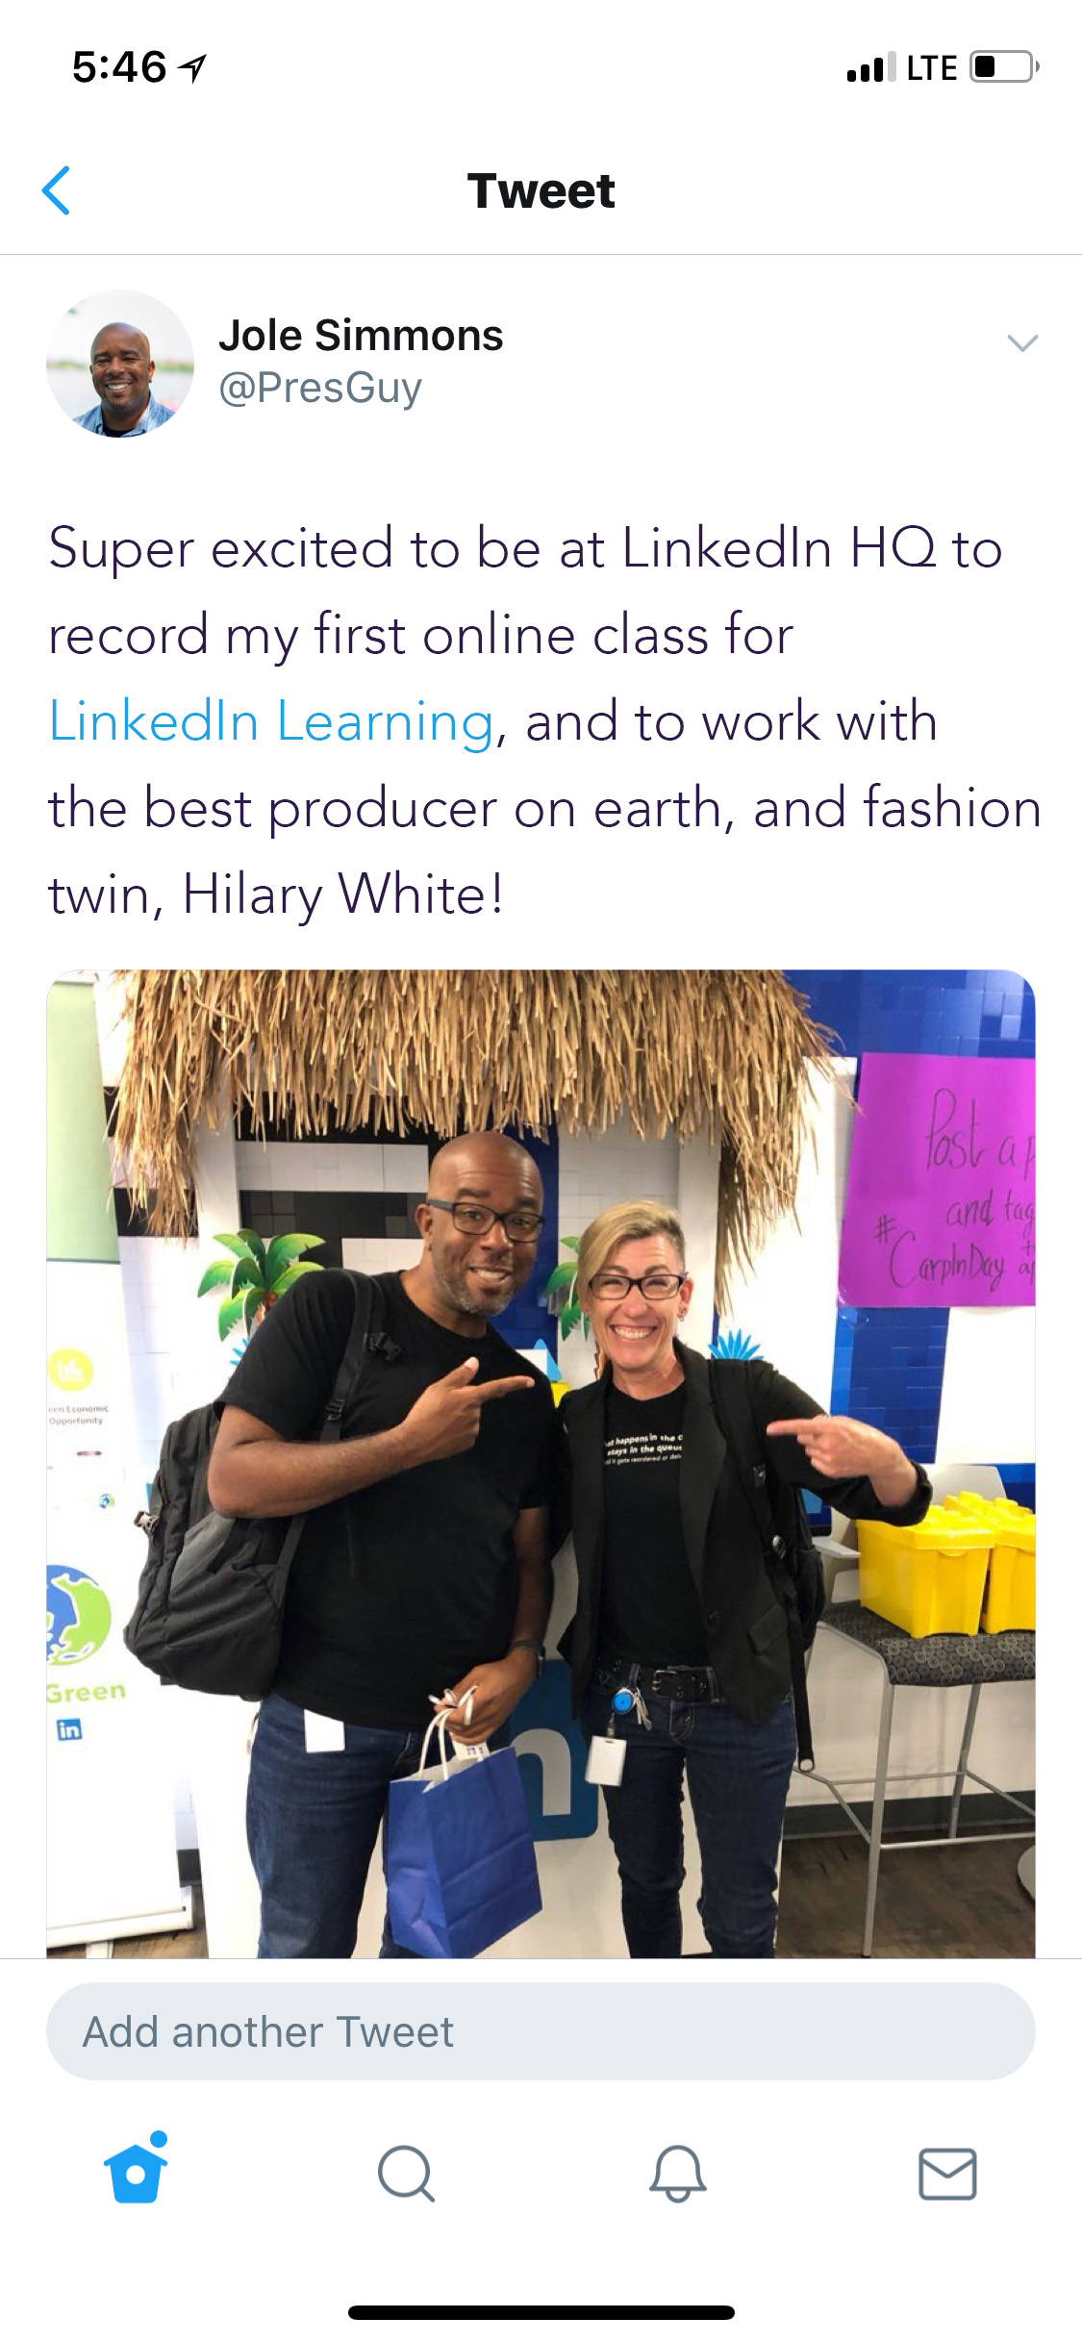
5:46
LTE
Tweet
Jole Simmons
@PresGuy
Super excited to be at LinkedIn HQ to
Record my first online class for
LinkedIn Learning, and to work with
the best producer on earth, and fashion
twin, Hilary White!
Add another Tweet

Slide 2
5:46
LTE
Tweet
Jole Simmons
@PresGuy
Super excited to be at LinkedIn HQ to
Record my first online class for
LinkedIn Learning, and to work with
the best producer on earth, and fashion
twin, Hilary White!
Add another Tweet

Slide 3
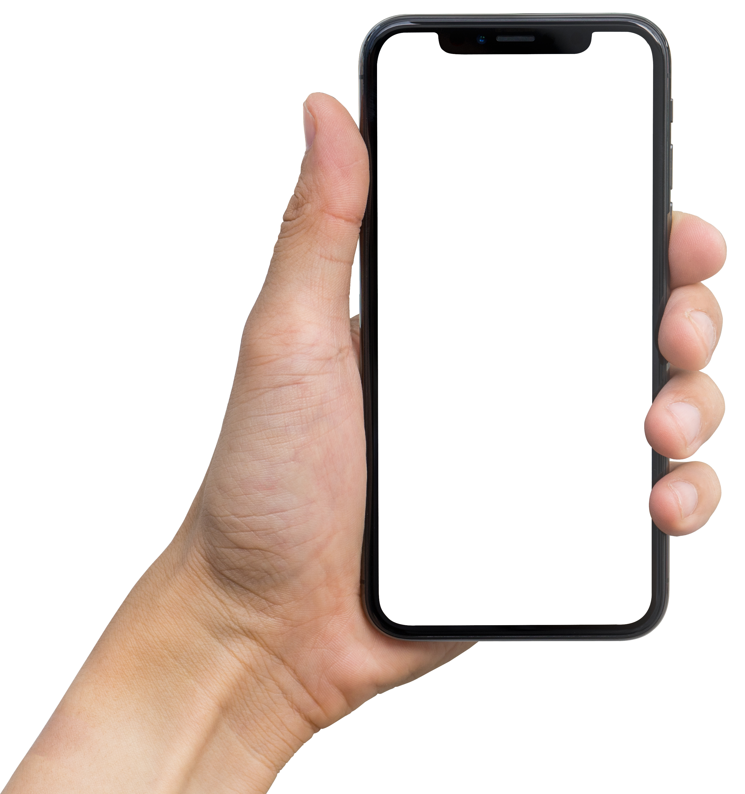
5:46
LTE
Tweet
Jole Simmons
@PresGuy
Add another Tweet

Slide 4

5:46
LTE
Tweet
Jole Simmons
@PresGuy
Super excited to be at LinkedIn HQ to
Record my first online class for
LinkedIn Learning, and to work with
the best producer on earth, and fashion
twin, Hilary White!
Add another Tweet

Slide 5
5:46
LTE
Tweet
Super excited to be at LinkedIn HQ to
Record my first online class for
LinkedIn Learning, and to work with
the best producer on earth, and fashion
twin, Hilary White!
Jole Simmons
@PresGuy
Add another Tweet

